Slide 1


Predicting Timely Adoption and Optimizing Adoption Channels for Shelter Animals
Rebecca V. Lewis
Bellevue University, Omaha, NE
DSC 630 - Amirfarrokh Iranitalab
August 8, 2020

Slide 2
Introduction
Live Release Outcomes
Return to Owner
Adopted
Intake
Owner Surrender
Transfer In
Stray / Animal Control
Transfer
Lost
The rate of intake in animal shelters surpasses the rate of adoption at most animal shelters
According to research estimates from the American Society for the Prevention of Cruelty to Animals (1), over 6.5 million pets enter shelters each year [1]. Of those, approximately 1.5 million animals are euthanized
NO KILL <> NO CAGE
Notes:
According to research estimates from the American Society for the Prevention of Cruelty to Animals (ASPCA), over 6.5 million pets enter shelters each year. Of those, approximately 1.5 million animals are euthanized.
A common approach to decreasing euthanasia is to abruptly stop euthanizing animals. In reality, this often creates larger problems that more detrimental to the health of the entire population in the shelter. In reality, a completely “No Kill” community does not exist; in fact, other countries, such as Italy, have passed this type of legislation and inadvertently created another problem of overpopulation, skyrocketing cost, and plummeting quality of care, and increased public safety concern with dogs being dumped on the streets.
Both municipal and privately owned shelters are always looking for and creating programs to move their adoptable animals faster. Reducing the length of stay for animals in the shelter through adoption, as opposed to euthanasia, is a cost-effective solution that can make room for new animals coming in and optimize the shelter’s resources. Using characteristics about the animals to place them in the appropriate adoption program can increase their likelihood of adoption.

Slide 3
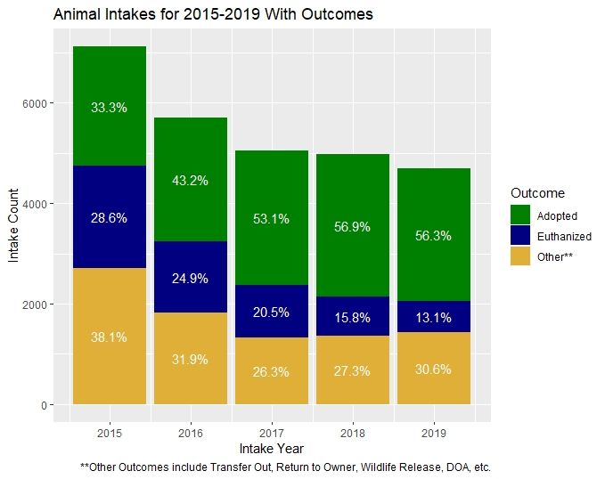
Animal Intakes for 2015-2019 with Outcomes
Notes:
The data used to conduct this analysis comes from the Louisiana SPCA located in Algiers, Louisiana, considered a leader in the local animal welfare community and highly regarded by national organizations when it comes to innovation in reducing intakes and increasing live release of animals in its care.
Here we see the intake of animals has steadily decreased over the last five years and while the adoption rate was increasing, it has plateaued in the last couple of years. Are there ways to optimize the adoption rate based on the animal’s demographics and controllable factors in the adoption?

Slide 4

Challenges
Choosing the Right Data
Exceptions to the Rule
Not all adoption factors are controllable.
What types of live release programs can be improved upon to reduce euthanasia? What breed of animal do we focus on? How many years of data is relevent?
Animals often find themselves in the shelter multiple times. How do we handle animals with multiple intakes? Sometimes animals are taken in from other organizations. Does that change our analysis?
We know factors like age, breed and size impact an animal’s adoptability but these qualities cannot be changed by the organization. Are there other factors that impact animal placement that can be controlled to improve outcomes?
This Photo by Unknown Author is licensed under CC BY-NC

Slide 5
Objective
Can we predict the Dogs and Cats most likely to be adopted within 7 days?
Can this information be used to route the animal to the best adoption channel?
Notes:
The objective of this project is to determine if taking a closer look at shelter data and animal characteristics can not only predict:
the likelihood that an animal will be adopted out quickly thus allowing us to target extra effort on those who are not typically adopted quickly.
Can we use information gathered about the animal to decrease their length of stay by effectively routing them through the best adoption channel.

Slide 6
Data Understanding
The main dataset for the analysis contains intakes from 1/1/2015 through 12/31/2019 with an adoption date by 2/29/2020.
The data was filtered to only include cats and dogs with only one intake between 1/1/2015 and 12/31/2019.
The initial dataset contains 10490 observations and 32 variables to be used in Exploratory Data Analysis.
Preliminary summary statistics were viewed on each variable, and variables with a large amount of nulls, little variation in values, and personal information related to the employee or client were excluded.
Notes:
Input features will be taken from dogs and cats whose intake date was between January 1, 2015 and December 31, 2019 with an adoption date by February 29, 2020. This cutoff date was chosen to avoid any inconsistencies related to changes to operations made in response to the COVID pandemic.
The initial dataset include 10490 observations and 32 variables.
To gain a better understanding of the data: Preliminary summary statistics were viewed on each variable, and variables with a large amount of nulls, little variation in values, and personal information related to the employee or client were excluded.

Slide 7
Variable Exploration
The dataset contains 4617 cat observations and 5873 dog observations. Dogs and cats will be analyzed separately as they have different factors that can impact adoptability.
Some variables are only populated for certain intake types. Visuals are used to get a better idea of when the data is populated. If we decide to model the data for intake types separately, these variables would be useful as features. These variables are Intake Subtype, Intake Reason, Intake Agency Association, and Length Owned.
Kittens and puppies below 2 months of age were removed from the data set because they are often in foster care for weeks until they are old enough to be placed for adoption. 2359 records were removed from the dataset meeting this criteria.
Duplicate observations were observed for adopted animals who were returned to the shelter, creating challenges with merging data together. These records represented a small percentage of the population and were removed.
Notes:
The following discoveries were made through the exploratory data analysis process:
Dogs and cats will be analyzed separately as they have different factors that can impact adoptability. There are 4617 cat observations and 5873 dog observations in the dataset
Variables populated specific to intake type would only be impactful on the analysis if the data was modeled for each intake type separately which is beyond the scope of this project. IntakeSubType, IntakeReason, IntakeAgencyAssociation, LengthOwned, and LengthOwnedUnits were removed from the dataset.
Kittens and puppies below 2 months of age were removed from the data set because they are often in foster care for weeks until they are old enough to be placed for adoption. 2359 records were removed from the dataset meeting this criteria
If an animal was adopted and returned to the shelter, that animal will have more than one record in this raw data file. Returned animals represented a very small percentage of the total number of records so they were filtered out of the data.

Slide 8
Numerical Variables
Dogs
Cats
Variable | Min | Max | Mean | Std_dev | Skewness | Kurtosis | IQR
IntakeAgeMonths | 2 | 212 | 30.13829 | 31.52417 | 1.73783 | 6.112354 | 28
Variable | Min | Max | Mean | Std_dev | Skewness | Kurtosis | IQR
IntakeAgeMonths | 2 | 204 | 20.47779 | 29.36719 | 2.638367 | 11.27403 | 21
Notes:
The age of the animal in months is the only numeric variable.
The distribution for both cats and dogs is not normal with a positive skew as indicated by the max value being so much higher than the mean and the large positive values in skew.

Slide 9
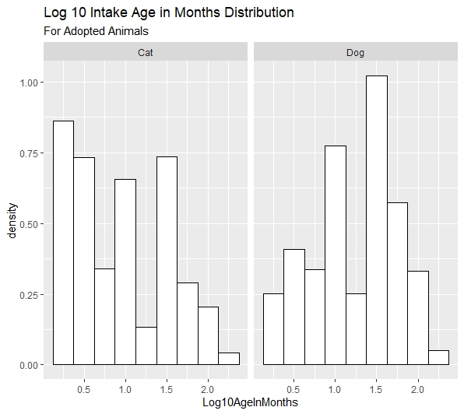
Numerical features
Notes:
After a log10 transformation is applied to the variable the distribution is more uniform for cats and close to normal for dogs.

Slide 10
Categorical Variables - Dogs
Variable | Levels | Mode | Frequency | % of Population
PrimaryBreed | 153 | Terrier | 597 | 11.02%
Gender | 2 | Male | 2800 | 51.7%
IntakeDateOnly | 1625 | 2016-08-30 | 19 | .35%
OutcomeDateOnly | 1635 | 2016-07-23 | 45 | .83%
IntakeAsilomar | 4 | Healthy | 3316 | 61.23%
IntakeCondition | 12 | Appears Normal | 2960 | 54.65%
IntakeType | 4 | Stray | 2082 | 38.44%
OutcomeAsilomar | 4 | Healthy | 3258 | 60.16%
OutcomeSubType | 10 | Onsite | 4444 | 82.05%
Size | 4 | Small | 2698 | 49.82%
IntakeLocation | 31 | 10 Dog Healthy Hold | 2541 | 46.92%
IntakeSubLocation | 104 | Cage 2 | 494 | 9.12%
PreAltered | 3 | N | 4168 | 76.96%
OutcomeLocation | 15 | 00 Dog Adoption Condo | 3222 | 59.49%
OutcomeSubLocation | 144 | 20 Foster Care | 611 | 1128%
Derived Fatures:
PitBullType Breed
Mixed Breed
AsilomarImprovement
Heartworm
SickInjured
SkinCondition
Emaciated
Feral
IntakeMonth
Intake Weekday
Small Animal
AlteredAtIntake
Encouragement
Foster
Offsite
Notes:
The categorical variables identified as the most interesting to use as features are shown here with the corresponding frequency measures. As you can see, many of the variables have a high cardinality and are very imbalanced. The following features were derived from this information:
PitBullType Breed – dogs that are one of the following breeds that are commonly associated or confused with ‘Terrier, Pit Bull’, ‘Terrier, American Pit Bull’, ‘Bulldog, American’, ‘Terrier, American Staffordshire’, ‘Terrier, Staffordshire Bull’, and ‘Bullmastiff’
Mixed Breed – dogs where a specific breed wasn’t specified in the primary breed and instead mixed was used.
AsilomarImprovement – The intake asilomar and outcome asilomar were used to create a variable that indicates whether the status of the animal improved before adoption.
Intake condition was used to indicate whether an animal had one of the following ailments at intake:
Heartworm – whether the dog had heartworms at intake
SickInjured – whether the dog was sick or injured at intake
SkinCondition – whether the dog had a skin condition at intake
Emaciated – whether the dog was emaciated at intake
Feral
The intake date as used to create the IntakeMonth and Intake Weekday features
A flag was created from size to create a SmallAnimal feature
AlteredAtIntake was one hot encoded from the prealtered status
Encouragement was derived from the Intake and Outcome locations to determine if the dog was every in the encouragement room for extra support
Foster indicates if the animal was part of the foster program
Offsite indicates if the animal was part of the offsite program

Slide 11
Categorical Variables - Cats
Variable | Levels | Mode | Frequency | % of Population
PrimaryBreed | 21 | Domestic Shorthair | 2247 | 84.60%
Gender | 2 | F | 1405 | 52.90%
IntakeDateOnly | 1104 | 2016-04-14 | 14 | .53%
OutcomeDateOnly | 1180 | 2019-08-17 | 19 | .72%
IntakeAsilomar | 4 | Healthy | 1874 | 70.56%
IntakeCondition | 11 | Appears Normal | 1716 | 64.61%
IntakeType | 4 | Stray | 1587 | 59.75%
OutcomeAsilomar | 4 | Healthy | 1904 | 71.69%
OutcomeSubType | 17 | Onsite | 1243 | 46.80%
Size | 4 | Small | 1370 | 51.58%
IntakeLocation | 23 | 04 Cat Feral Room | 1901 | 71.57%
IntakeSubLocation | 95 | 04 Cat Feral Room | 358 | 13.48%
PreAltered | 3 | N | 1646 | 61.97%
OutcomeLocation | 19 | 00 Cat Adoption Condo | 998 | 37.58%
OutcomeSubLocation | 126 | SCC | 323 | 12.16%
New features were derived from these variables to represent:
CatBreedSpecified
AsilomarImprovement
SickInjured
SkinCondition
Emaciated
Feral
IntakeMonth
Intake Weekday
SmallAnimal
AlteredAtIntake
Foster
Offsite
Notes:
Many of the same features were derived for cats as dogs with a few exceptions:
The encouragement room, pitbull type, and heartworm variables do not apply to cats
Most cats are considered mixed breeds so rather than creating a mixed breed flag, a feature was created to indicate whether the cat breed was specified.

Slide 12
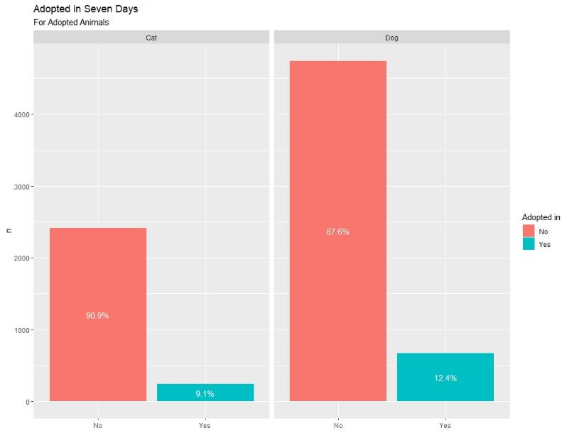
Target Variables
Adopted in Seven Days
Notes:
The classes for Adopted in Seven Days are highly imbalanced with only 9.1% of cats being adopted in 7 days and 12.4% of dogs being adopted in seven days. A model was chosen for this target with resampling in mind to balance the classes.

Slide 13
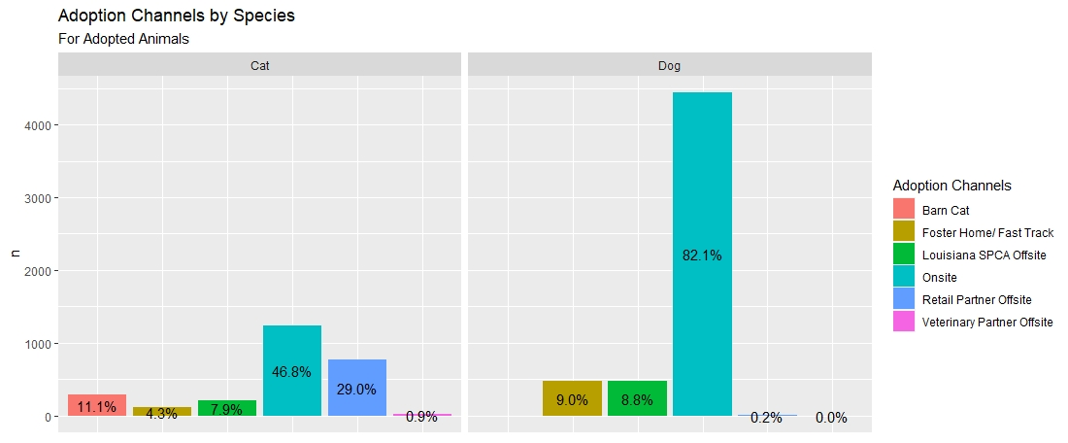
Target Variables
Adoption Channels
Notes:
Overall, dogs are more likely to be adopted from the Louisiana SPCA main campus while cats have a close second of offsite at a Retail Partner location.
Both cats and dogs are just as likely to be adopted from an offsite adoption event sponsored by the Louisiana SPCA.
Only cats can be adopted through the Barn Cat program obviously and the least likely place for both cats and dogs to be adopted from is a Veterinary Partner.
An interesting note is that the distribution of adoption channels is spread out much more than dogs which means cats have more potential adoption opportunities

Slide 14
Modeling
Timely Adoption
Predict whether an animal was adopted within 7 days of intake
Adoption Channel
A Support Vector Classifier was used with the kernel parameter set to linear, the class weight equal to balanced and probability as true.
A Random Forest ensemble method was used with the class weight set to balanced and max depths of 3, 5, and 8.
A Logistic Regression model with upsampling and downsampling on the target class and scaling using StandardScaler.
Predict the adoption channel that is best suited for an animal
Three decision tree classifiers were built with depths of 3, 5, and 8 using SMOTE to resample based on the target variable.
Three random forest ensemble classifiers were built using the class weight of balanced to handle imbalanced classes with maximum depths of 3, 5, and 8.
K-Nearest neighbor was used with and without SMOTE resampling on the target variable.
Notes:
The data was split into training and test sets. Any resampling took place on the training set only
In order to prevent bias, attention needed to be paid to imbalanced classes within the target variable. Multiple models were tested for each target and were chosen based on their ability to handle imbalanced targets.
For Timely Adoption, logistic regression as evaluated using both up and down sampling. A support vector classifier was evaluated using a class weight parameter value of balanced. And random forest classifiers were each evaluated with a class weight of balanced and depths of 3, 5, and 8.
For the Adoption Channel, SMOTE was experimented with for oversampling with the Decision Tree classifier with a depth of 3, 5, and 8. Random Forest was tested for the same depths using the class weight parameter to balance the classes. KNN was evaluated both with and without resampling the data

Slide 15
Results Timely Adoption Dogs
Random Forest (depth=8)
Accuracy – 71.42%
Recall for Yes – 25%
Recall for No – 93%
AUC – 74.63%
Notes:
Accuracy could not be the only metric used to evaluate the results; however, this model had the highest accuracy of all of the ones tested. It also had the best recall when it came to predicting the minority class of Adopted in 7 Days which was the biggest factor in choosing this model. The area under the cover for this model was among the highest values.

Slide 16
Results Timely Adoption Cats
Logistic Regression with Downsampling
Accuracy – 86.32%
Recall for Yes – 32%
Recall for No – 94%
AUC – 85.69%
Notes:
As with dogs, accuracy could not be the only metric used to evaluate the results; however, this model also had the highest accuracy of the ones tested. It also had the best recall when it came to predicting the minority class of Adopted in 7 Days of 32%. The area under the cover for this model was also the highest value.
An interesting note is that the predictor for the adoption of cats within 7 days is stronger than the one for dogs.

Slide 17
Results Adoption Channel - Dogs
Foster
K-Nearest Neighbors (k=5)
Accuracy – 78.81%
Specific Recall – 28%
AUC – 51.68%
Offsite
Random Forest (depth=8)
Accuracy – 63.28%
Overall Recall – 63%
AUC - 56.02%
Specific Recall – 15%
Overall Recall – 79%
Notes:
For dogs, on the Foster, Offsite and Onsite programs were evaluated because the other channels did not have enough observations
The Foster and Offsite features were removed before analysis to prevent future leakage.
The best model was chosen for each adoption channel other than Onsite. Because the data for Onsite was heavily biased, it would have good results in every model
For predicting animals suited for the foster program. The random forest models with a depth of 5 and 8 had a very close recall score specific to the foster program. The model with a depth of 8 had the highest overall accuracy and recall
For predicting animals suited for the offsite program, The best model was the KNN algorithm without resampling with SMOTE. It had the best overall accuracy and recall and recall specific to the Foster program. It was however the worst performing model for the foster program

Slide 18
Results Adoption Channel - Cats
Barn Cat
K-Nearest Neighbors (k=5) with SMOTE
Offsite
K-Nearest Neighbors (k=5)
Foster
Retail Partner
K-Nearest Neighbors (k=5)
Accuracy – 42.03%
Overall Recall – 42%
Specific Recall – 40%
Accuracy – 42.03%
Overall Recall – 42%
Specific Recall – 17%
Accuracy – 31.47%
Overall Recall – 31%
Specific Recall – 15%
Decision Tree (d=8) with SMOTE
Accuracy – 32.61%
Overall Recall – 33%
Specific Recall – 36%
Notes:
For cats, the veterinary offsite adoption channel did not have enough data to produce result.s
The Foster and Offsite features were removed before analysis to prevent future leakage.
The channels with the best performing models were the Barn Cat and Retail Partner programs.
For predicting animals suited for the barn cat program, The best model was the KNN algorithm without resampling with SMOTE. It produced the best specific recall out of all of the dog and cat models at 40%
The same model was best predictor for the foster program but the specific recall was not as good at 17%
Best model for predicting cats for offsite adoption was also KNN but with resampling using SMOTE. This specific recall for this predictor was also low at 15%
For predicting animals suited for the retail program, The best model was the Decision Tree Classifier using SMOTE. The specific recall for this model as 36%

Slide 19
Conclusion
The models used through the analysis of both target variables did not prove to be strong predictors. Further research should be performed with the following considerations:
Repeat timely adoption analysis with a longer window of 10-14 days.
Repeat adoption channel analysis for each channel independently as a binary target.
Notes:
While the results of this study do not solve the problem of reducing the length of stay for shelter dogs and cats, the results indicate that data science can be a helpful tool in improving shelter outcomes and provide a basis for continuing research.
This study can serve as the basis for continuing research to develop detectors for animals who are likely to be adopted quickly, so that animals who are not in that group can be used for special events, prime placement in the shelter and marketing campaigns. Potentially revisitng the time frame used can produce better results.
Similarly, continued research can be done on adoption channels independently with the aim of developing scores for animals to aid in making decisions on the specific channels they should be routed through

Slide 20
References
[1] Pet Statistics | Shelter Intake and Surrender | ASPCA. (n.d.). Retrieved June 13, 2020, from https://www.aspca.org/animal-homelessness/shelter-intake-and-surrender/pet-statistics

